Slide 1
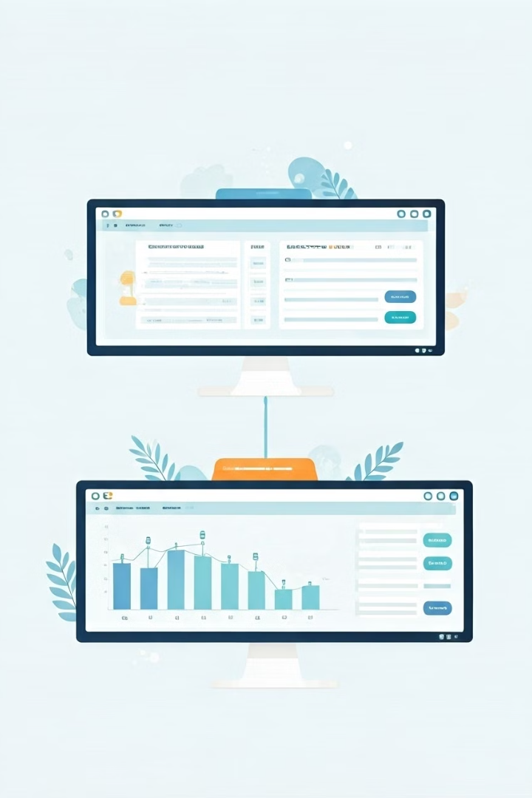
Inventory Management System
Developed using Python's Tkinter for a robust and user-friendly Graphical User Interface (GUI), this application seamlessly manages your product and category information through a PostgreSQL database. With functionalities for viewing, searching, modifying, deleting, and purchasing products, this comprehensive solution streamlines your inventory operations.

Slide 2
System Architecture Overview
Frontend
Backend
Integration
Deployment
The frontend of the application is built using Python's Tkinter library, providing a responsive and visually appealing GUI for users to interact with the system. Tkinter's cross-platform capabilities ensure the application can be accessed on various operating systems.
The backend is powered by a PostgreSQL database, which serves as the central repository for storing and managing all product and category information. This robust database solution ensures data integrity, scalability, and secure storage of critical business data.
The frontend and backend components are seamlessly integrated, enabling smooth data flow and real-time updates. Users can perform various inventory management tasks, and the changes are instantly reflected in the PostgreSQL database.
The entire application can be easily deployed on-premises or in the cloud, providing flexibility and scalability to meet the evolving needs of businesses of all sizes.

Slide 3

Database Design
1
Products Table
2
Categories Table
Stores detailed information about each product, including its name, description, price, quantity, and category.
Maintains a hierarchical structure of product categories, enabling users to organize and navigate the inventory effectively.
3
Orders Table
4
Customers Table
Keeps track of all customer orders, including order details, purchase date, and order status.
Stores customer information, such as name, contact details, and purchase history, to enhance the user experience and support analytics.

Slide 4
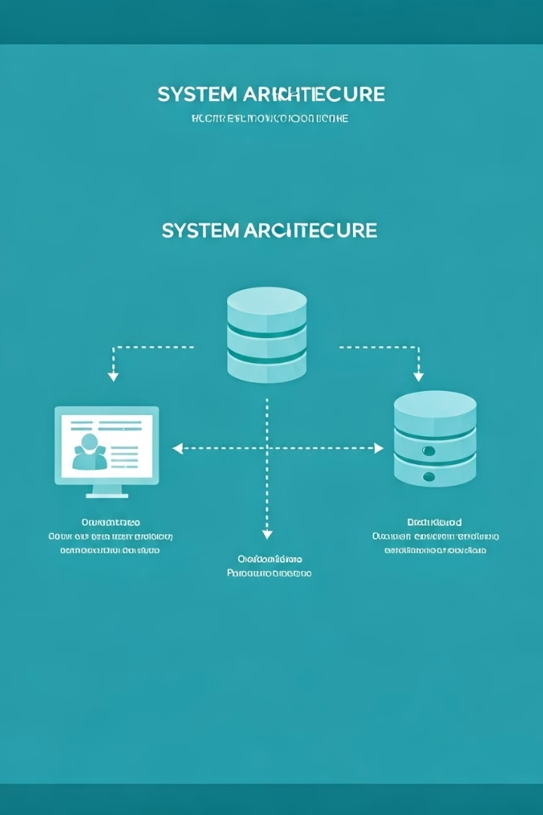
Data Flow Diagram
1
User Input
Users interact with the Tkinter-based GUI to perform various inventory management tasks, such as searching, creating, updating, and deleting products and categories.
2
Data Processing
The application's backend logic processes the user inputs, validates the data, and communicates with the PostgreSQL database to fetch, store, or update the necessary information.
3
Database Integration
The PostgreSQL database serves as the central repository for all product, category, order, and customer data. The backend seamlessly integrates with the database to ensure data consistency and reliability.
4
Reporting and Analytics
The system generates comprehensive reports and analytics based on the data stored in the PostgreSQL database, providing valuable insights to support business decision-making.

Slide 5
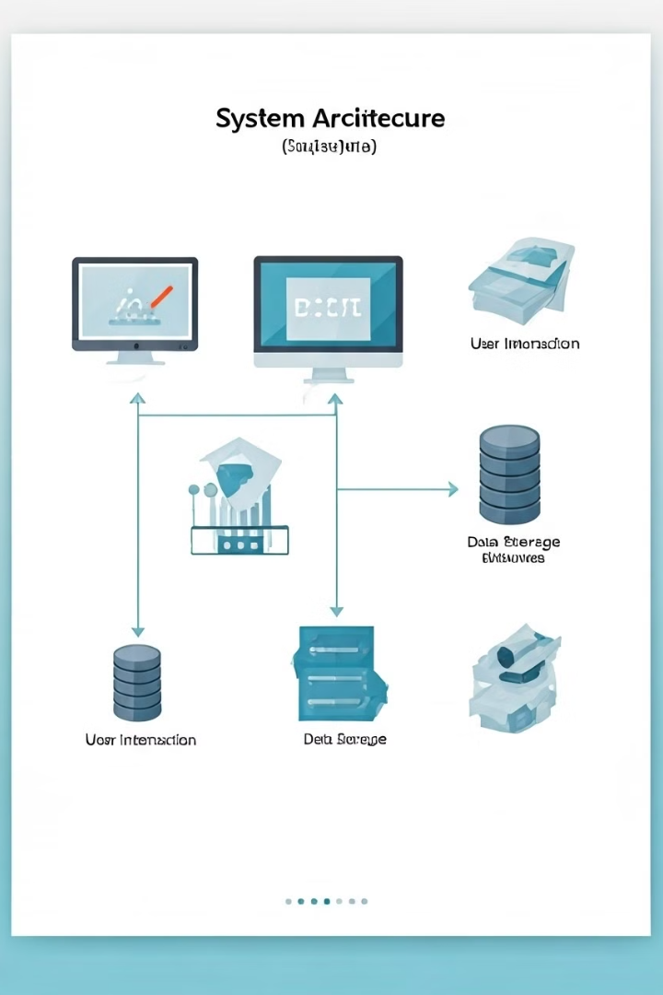
User Interface Modules
Login and Authentication
Product Management
Users can securely log in to the application using their credentials, with role-based access controls to ensure data privacy and security.
The intuitive product management module allows users to view, search, create, update, and delete products, as well as manage product categories and inventory levels.
Order Processing
Reporting and Analytics
The order processing functionality enables users to place new orders, track order status, and manage customer information, providing a seamless purchasing experience.
The reporting and analytics module generates customizable reports and visualizations to help users analyze sales trends, inventory levels, and other key performance indicators.

Slide 6
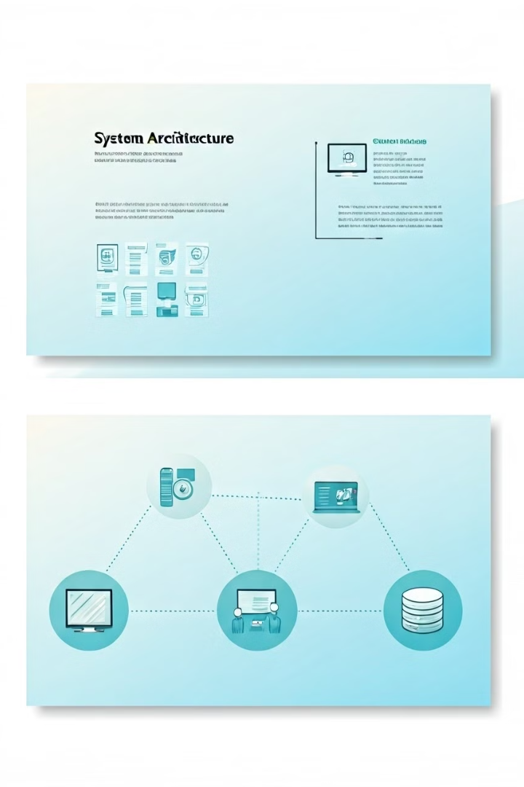




Product Management Functionalities
Search
Create
Users can quickly locate products by name, category, or other attributes, facilitating efficient inventory management.
The application allows users to add new products to the inventory, including details like product name, description, price, and quantity.
Update
Delete
Users can modify existing product information, such as updating prices, adjusting inventory levels, or changing product details as needed.
The system enables users to remove products from the inventory when they are no longer available or required.

Slide 7





Category Management Functionalities
Hierarchy
1
The category management module supports a hierarchical structure, allowing users to organize products into parent and child categories for enhanced navigation and visibility.
Add Category
2
Users can create new product categories, defining the category name, description, and its position within the hierarchy.
Update Category
3
The system enables users to modify existing category information, such as renaming, rearranging, or repositioning categories as needed.
Delete Category
4
Users can remove obsolete or unnecessary categories from the system, ensuring the category structure remains up-to-date and relevant.
Associate Products
5
Products can be easily associated with their respective categories, simplifying product organization and enabling intuitive search and browsing functionality.

Slide 8
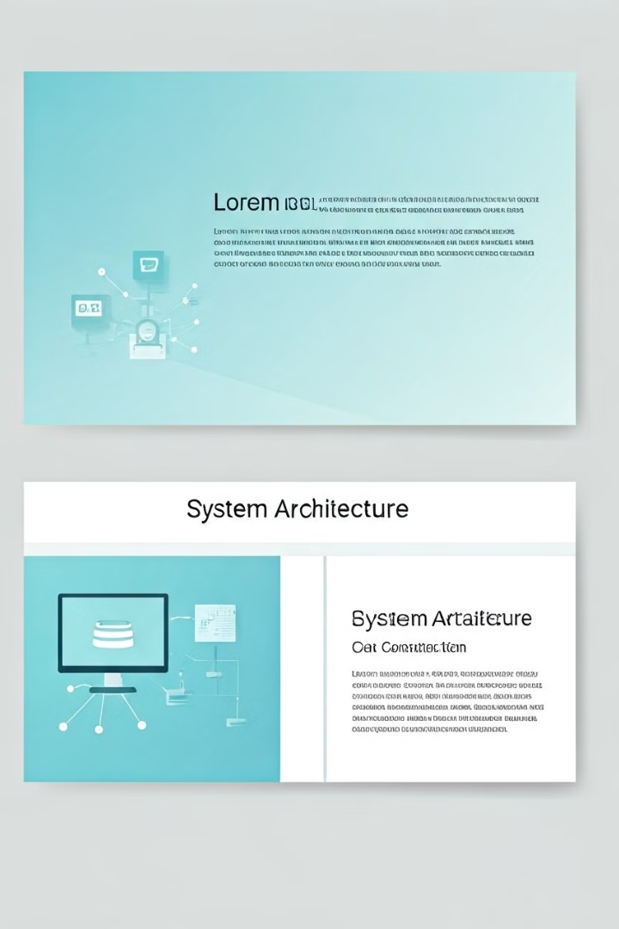
Reporting and Analytics
30
15
Sales Reports
Inventory Reports
Generate comprehensive sales reports, including total revenue, best-selling products, and customer purchase patterns.
Monitor inventory levels, identify slow-moving products, and optimize restocking strategies based on historical data.
10
5
Customer Analytics
Customizable Dashboards
Gain valuable insights into customer behavior, such as repeat purchases, average order value, and customer lifetime value.
Develop personalized dashboards to visualize key performance indicators and support data-driven decision-making.

Slide 9
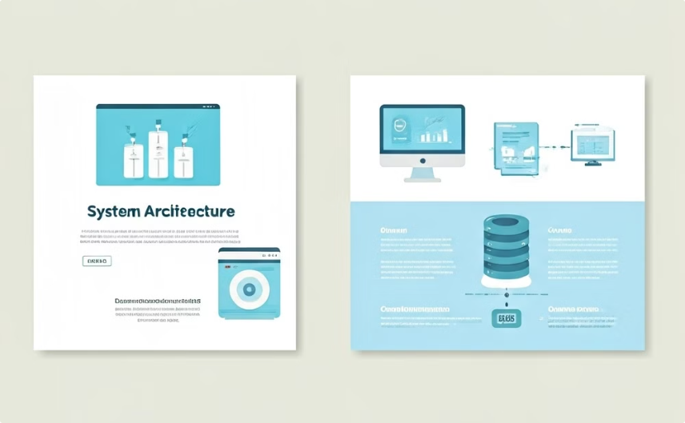
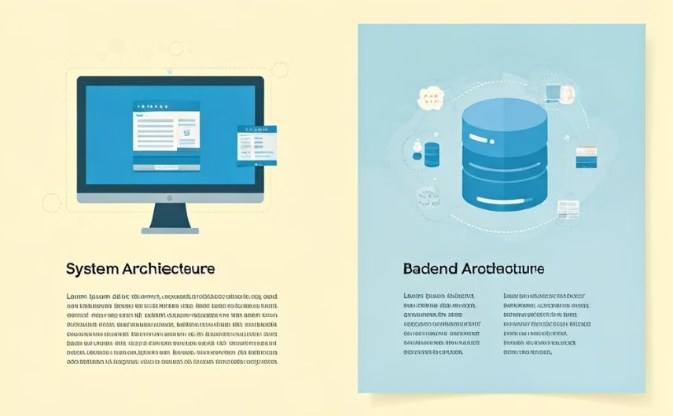
Powered by Tkinter and PostgreSQL
Python Tkinter
PostgreSQL Database
The Inventory Management System is built using Python's Tkinter library, providing a robust and user-friendly Graphical User Interface (GUI) for seamless interaction with the application.
The backend of the application is powered by a PostgreSQL database, ensuring secure and scalable storage of all product, category, order, and customer data, enabling comprehensive reporting and analytics.
By leveraging the strengths of Tkinter and PostgreSQL, the Inventory Management System delivers a reliable, efficient, and feature-rich solution for businesses to manage their inventory, streamline operations, and make data-driven decisions.

